Slide 1

Best Subway Route in Seoul
using by Dijkstra, A*, Transit algorithm
00000000 김수현
23102318 김은주
00000000 장승호

Slide 2

Table of Contents
Problem statement
Dijksta Algorithm
A* Algorithm
Transit Algorithm
Analysis

Slide 3

Problem
statement

Slide 4
Problem statement
Input
The start and end stations are given. Their format is flexible and can be chosen freely.
Output
Return the optimal subway route from the start station to the end station based on the provided subway data (see Figure 1). We included the route, the total travel time, and the final answer.

Slide 5
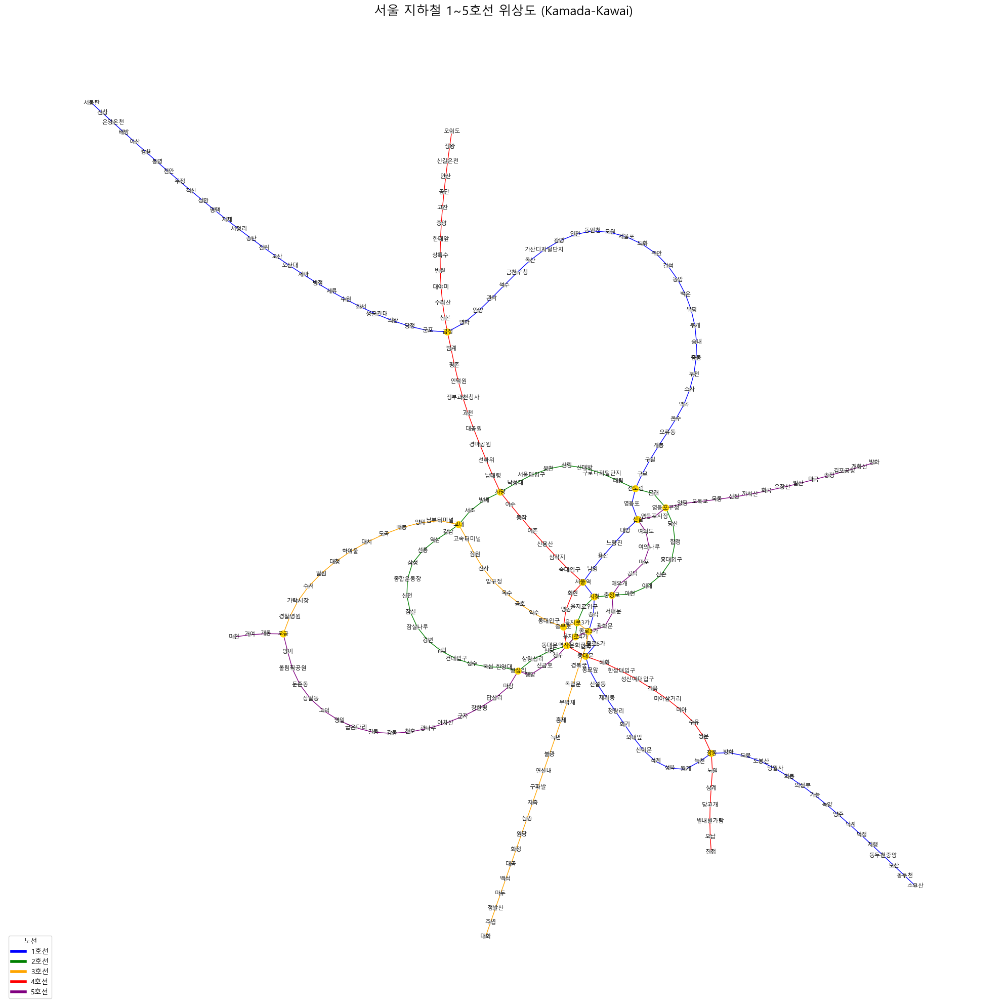
Figure 1
The graph view
of given subway data
Specific ..
The travel time between adjacent stations is 2 minutes.
The transfer time between lines is also 2 minutes.

Slide 6
Dijkstra
Algorithm

Slide 7
제목
소제목1
본문1.
소제목2
본문2.
소제목3
본문3.

Slide 8
제목
소제목
본문

Slide 9
A*
Algorithm

Slide 10
제목
소제목1
본문1.
소제목2
본문2.
소제목3
본문3.

Slide 11
제목
소제목
본문

Slide 12
Transit
Algorithm

Slide 13
제목
소제목1
본문1.
소제목2
본문2.
소제목3
본문3.

Slide 14
제목
소제목
본문

Slide 15
Analysis

Slide 16
Analysis
.

Slide 17

Thank you
for listening!
이상으로 발표를 마치겠습니다.

